Slide 1
MULTI-CUT-OFF REBAR
Advisor : Prof. K.C.Chang
Presenters : You-Ran Nai
Notes:
Try 講清楚脈絡

Slide 2
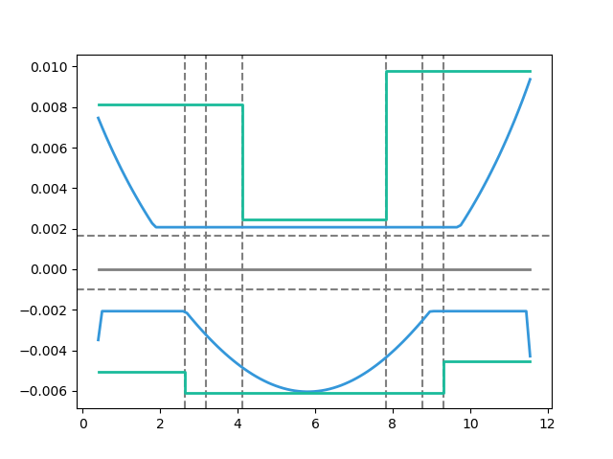
Max
Max
Design As
Today’s Solution
Fixed Bar-Cut
Max
Demand As
Notes:
LowSeismic4Floor12M 0
加上座標

Slide 3
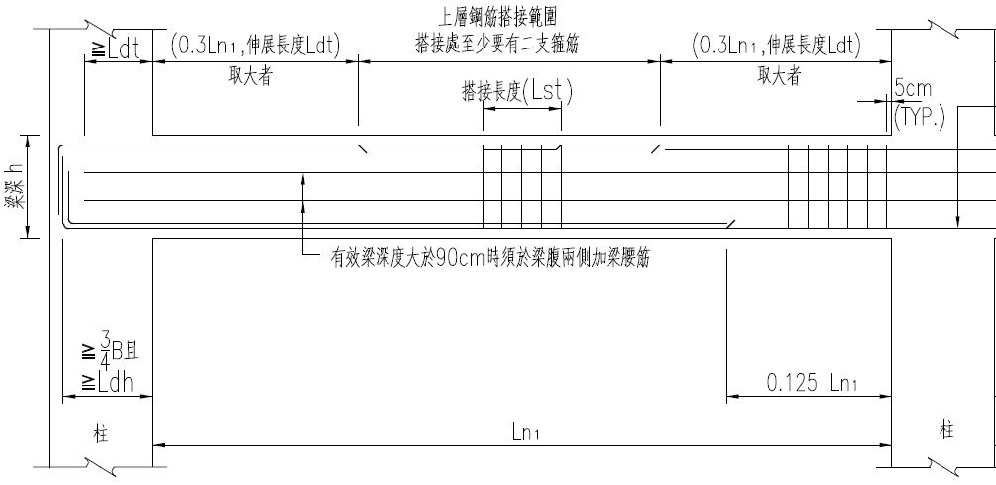
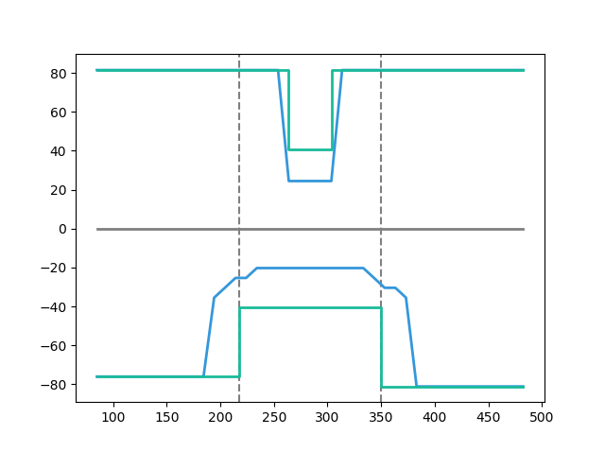
大梁鋼筋配置標準圖
Tradition
Design As
Demand As
Notes:
欣銓 1140
加上座標

Slide 4
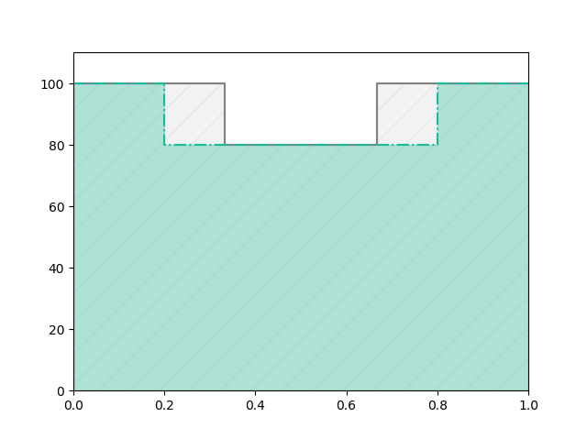
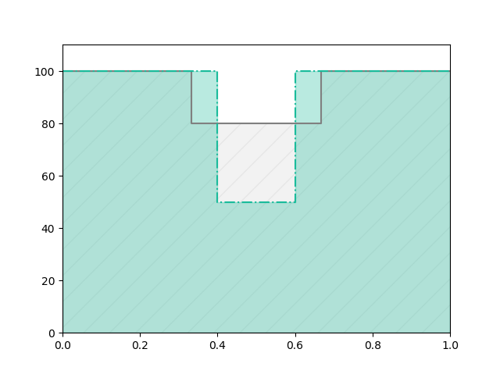
Before
After
REDUCE REBAR
Before
Real
Demand
After
Notes:
# 問題與目標
目前工程上斷筋處都固定在 1/3 或是 1/5 處
之所以這樣是為了施工上比較方便
但是這樣會有不經濟的問題產生
如果我們能做到根據需求來決定斷筋處
就能節省鋼筋的用量

Slide 5
Outline
Part 2
Part 4
Shear Reinforcement
Nonlinear Verification
Part 1
Part 3
Flexural Reinforcement
Condition

Slide 6
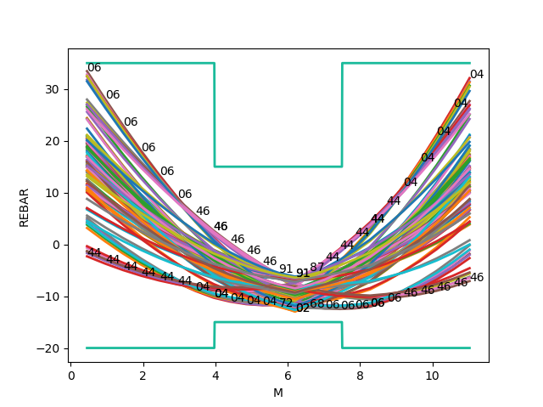
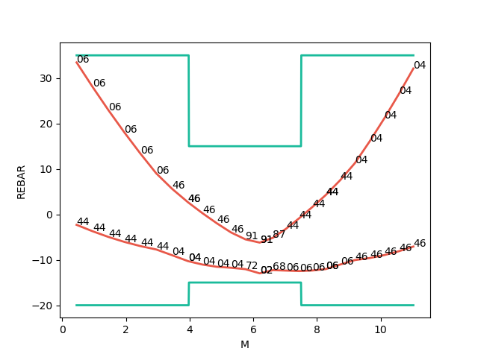
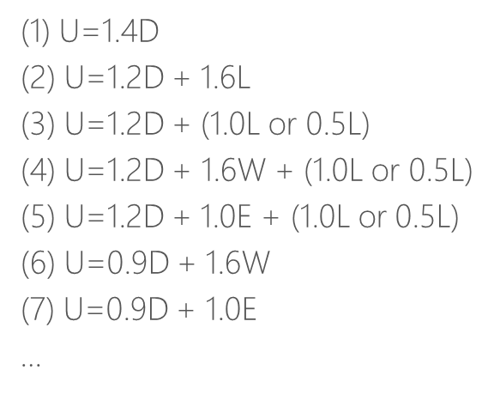
Mu
Consider Hundreds Of Combo Demand
Catch Critical Demand Combo

Slide 7
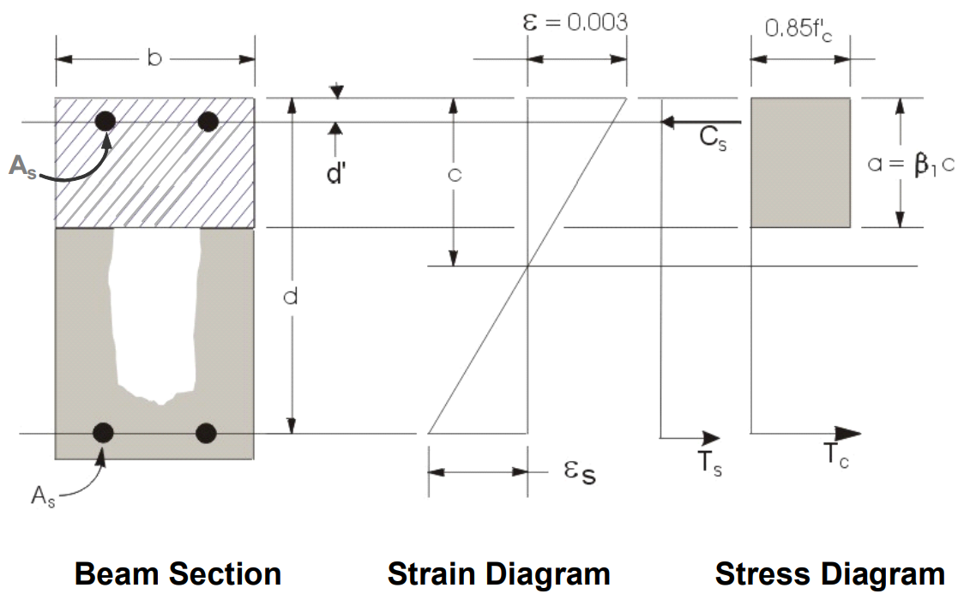
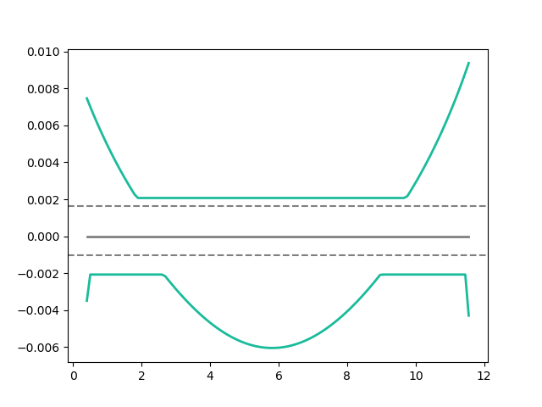
Flexural Reinforcement
Area of flexural reinforcement
Min: 2 Rebar

Slide 8
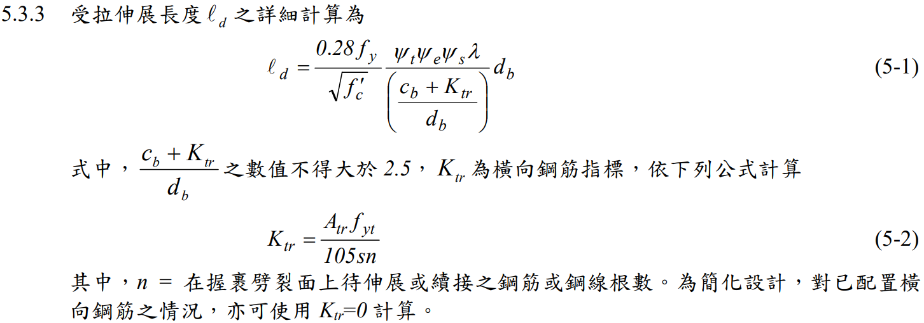
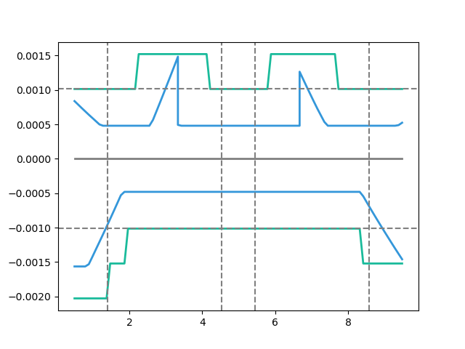
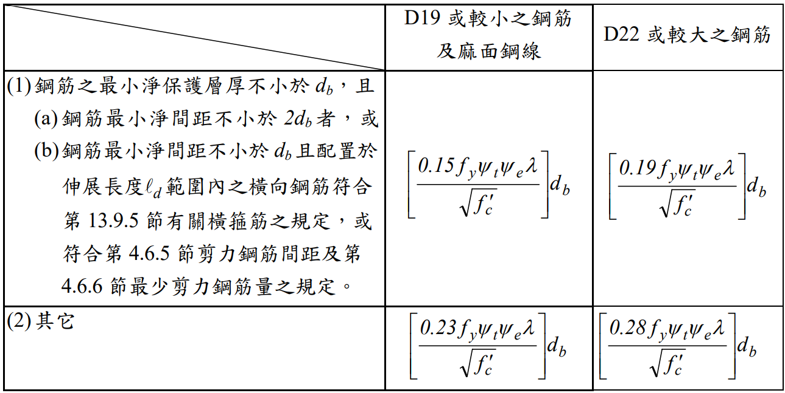
General Development Length Equation
Development Length
MIN
Demand As
Simplified Provisions
Development Length

Slide 9
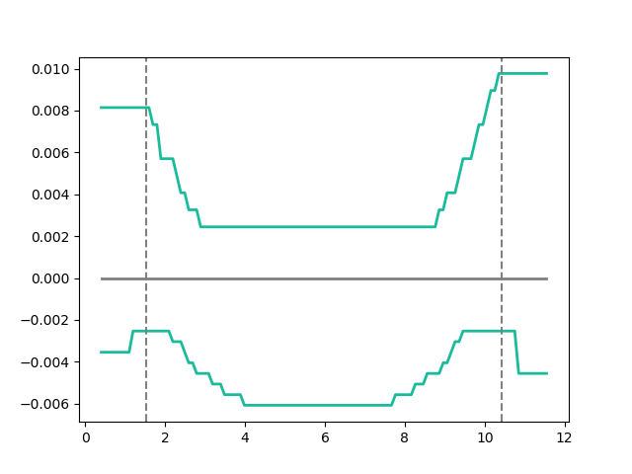
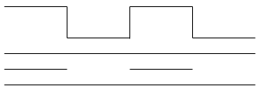
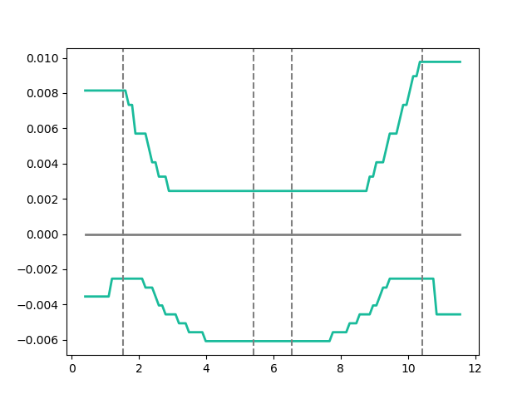
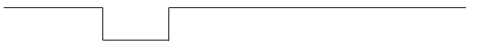
Combinations
As
多點
0.1
0.9
漸進式退縮
三段
0.1
0.45
0.55
0.9
Notes:
GA 演算法

Slide 10
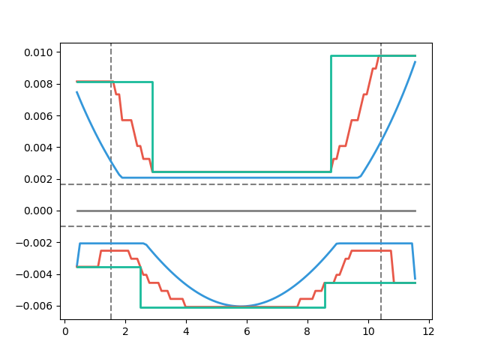
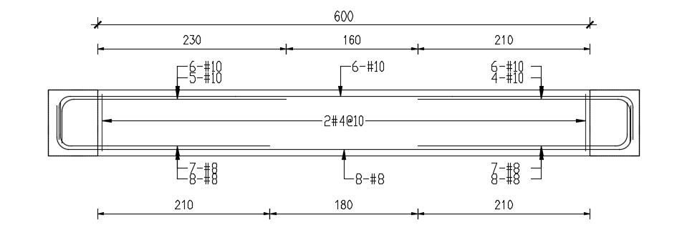
Development Length
梁撓曲鋼筋配置示意圖
Design As
Demand As

Slide 11
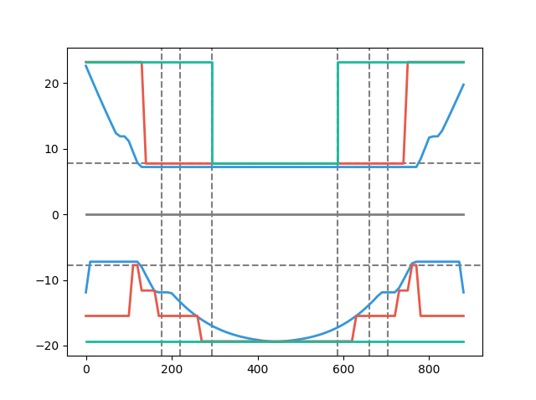
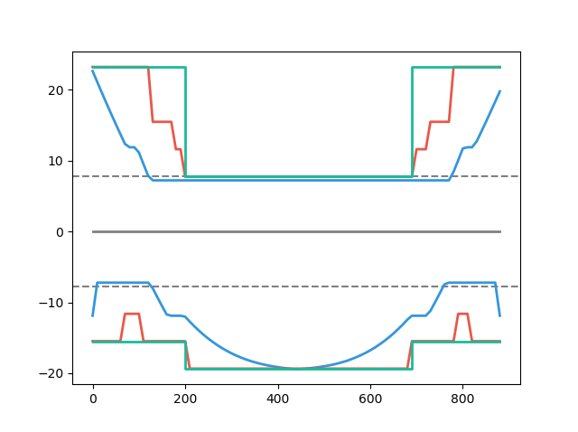
Simple Conclusion
Tradition
Simplified Ld
Multi-Cut
Design As
Design As
Explicit Ld
100%
80%
Demand As
Demand As
100%
91%
Notes:
高雄物流中心 11076

Slide 12
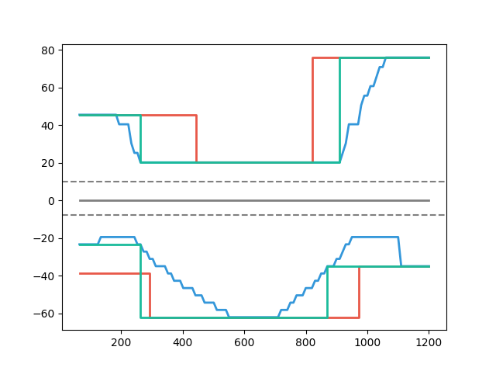
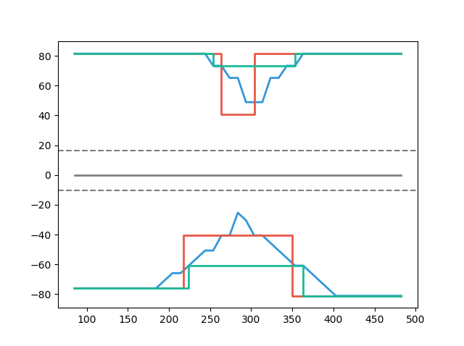
Case Study
Multi-Cut 82%
Tradition
Multi-Cut
Tradition
Development Length
Development Length
Multi-Cut 91%
Multi-Cut
Notes:
傳統不經濟
828
傳統不保守 不符合 混凝土結構設計規範 401-100 R5.11.2
1140

Slide 13
Outline
Part 2
Part 4
Shear Reinforcement
Nonlinear Verification
Part 1
Part 3
Flexural Reinforcement
Condition

Slide 14


Slide 15
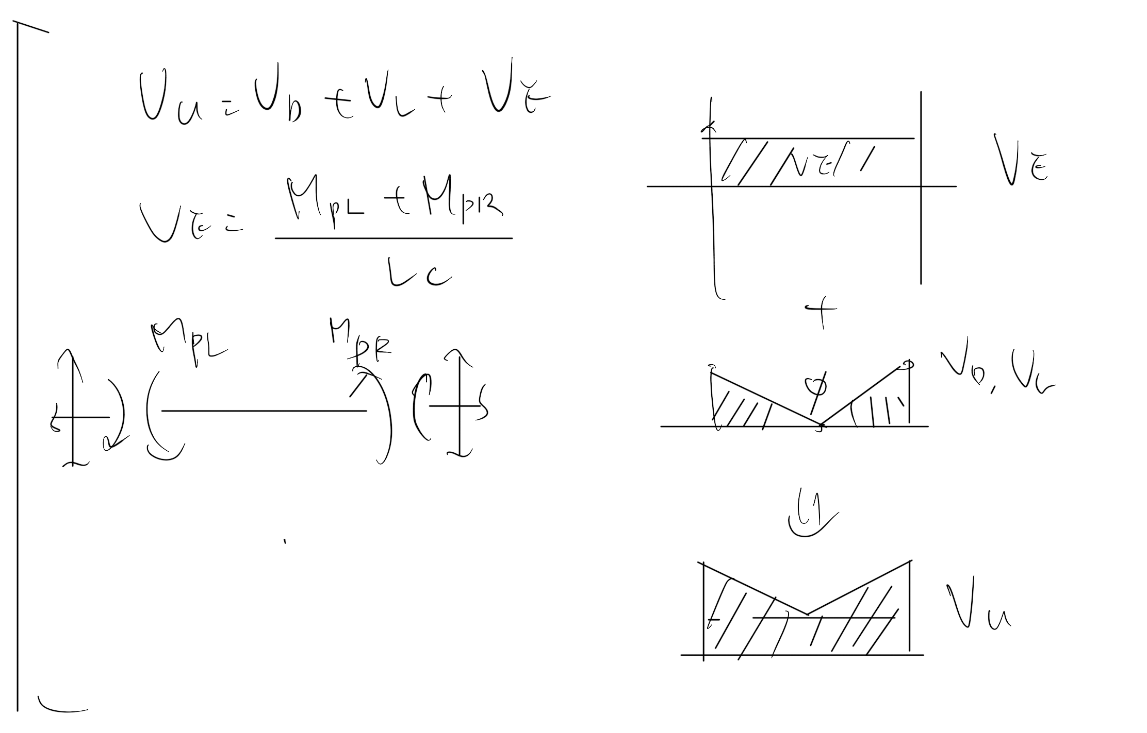
Vu
Notes:
LowSeismic4Floor12M 0

Slide 16
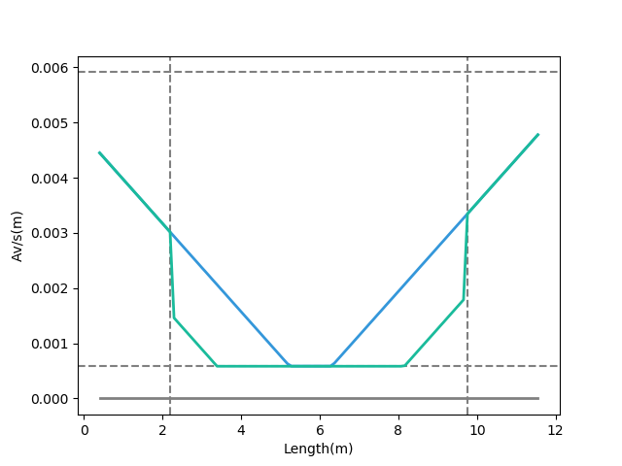
Shear Reinforcement
Vu
Notes:
LowSeismic4Floor12M 0

Slide 17
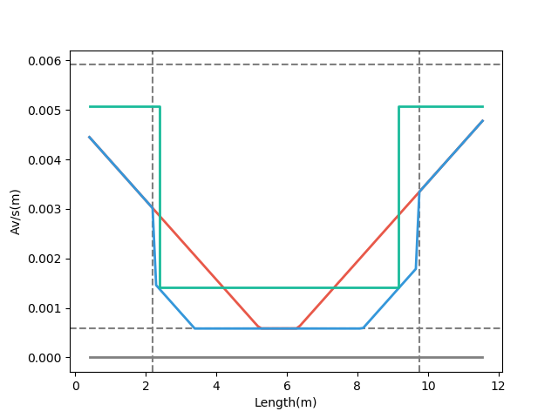
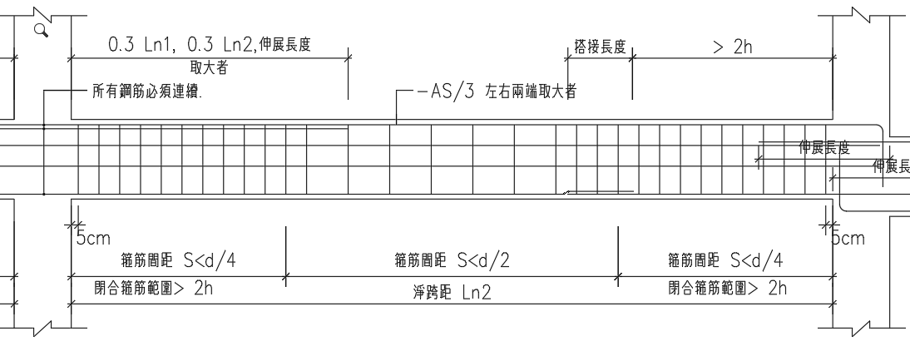
梁剪力鋼筋配置示意圖
Design Av
Demand Av
Consider Vc Demand
Notes:
LowSeismic4Floor12M 0

Slide 18
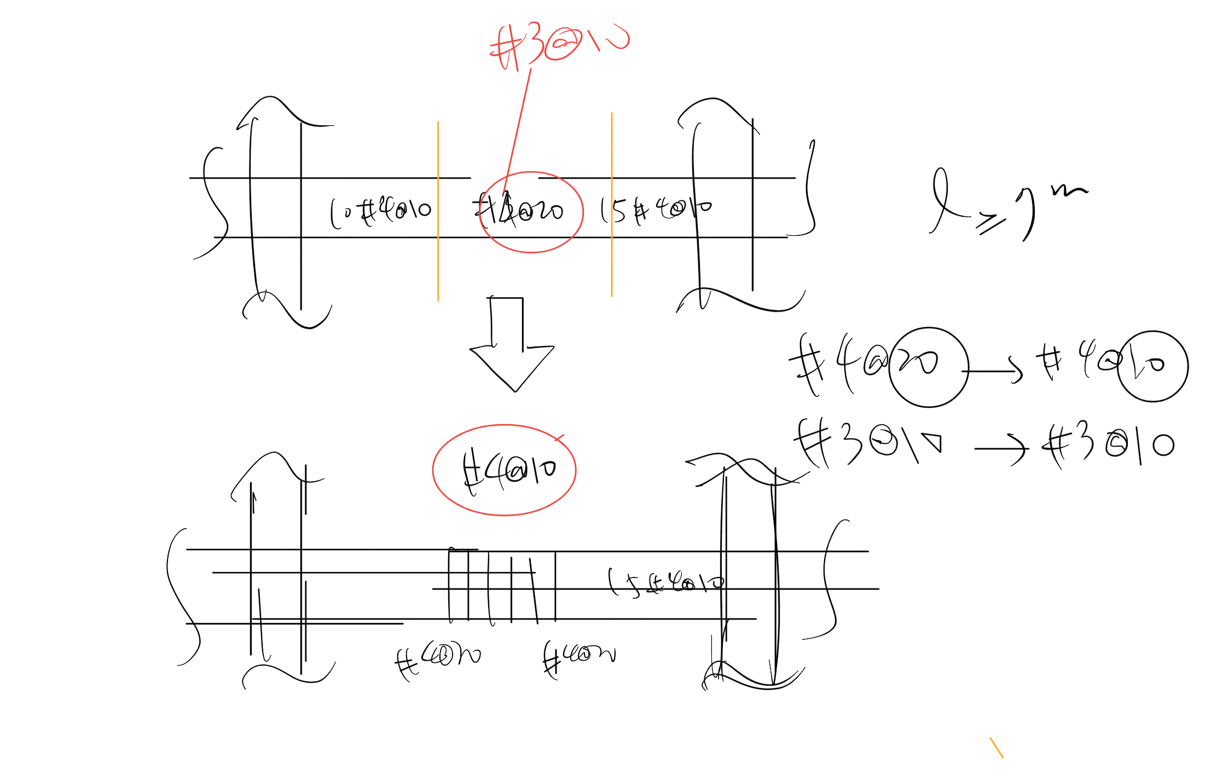

Slide 19
Outline
Part 2
Part 4
Shear Reinforcement
Nonlinear Verification
Part 1
Part 3
Flexural Reinforcement
Condition

Slide 20
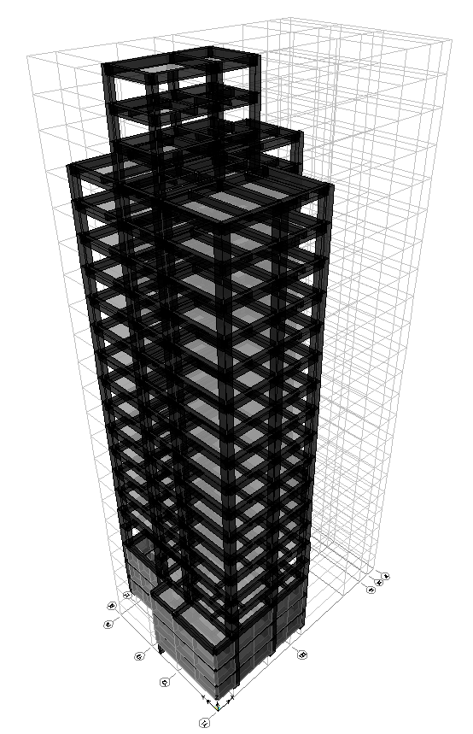
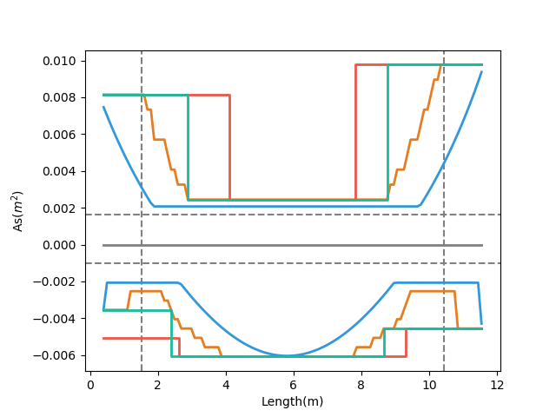
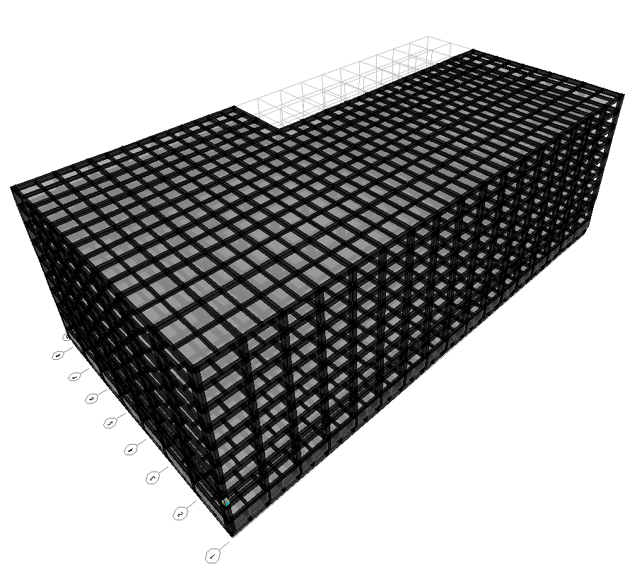
台北住宅案
Multi-Cut As
Development Length
Tradition As
Demand As
高雄物流中心
Notes:
LowSeismic4Floor12M 0

Slide 21
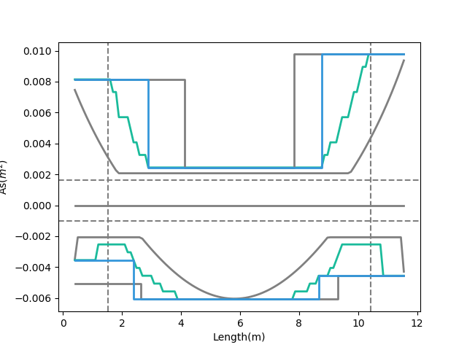
Development Length
Multi-Cut As
Short Development Length
Tradition As
Beam Length
Demand As
Notes:
LowSeismic4Floor12M 0

Slide 22
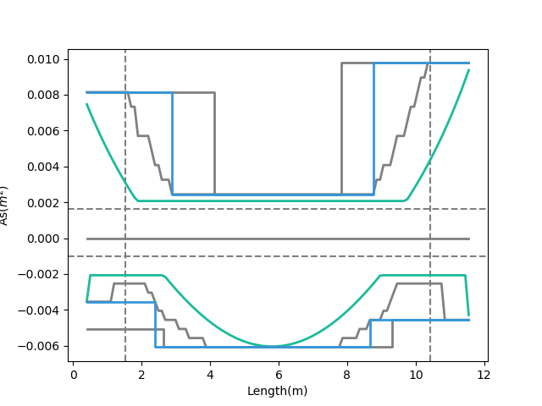
Multi-Cut As
Tradition As
Moment Decay
Demand As
Notes:
LowSeismic4Floor12M 0

Slide 23
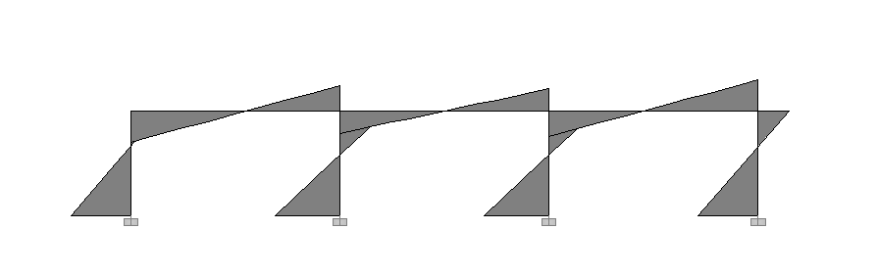
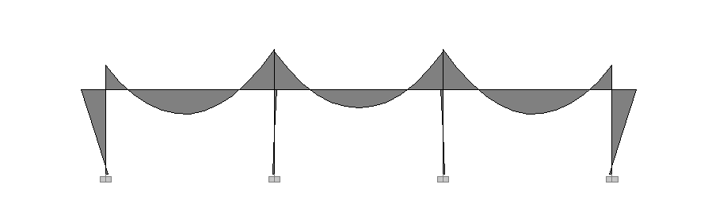
Seismic Load
Lateral
Force
Moment Diagram
Gravity Load
Gravity Load

Slide 24
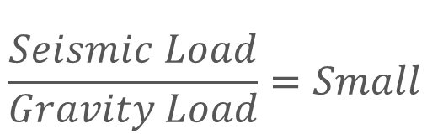
Lateral
Force
Moment Decay
$$\frac{Seismic Load}{Gravity Load}=Small$$
Gravity Load
Beam Length

Slide 25
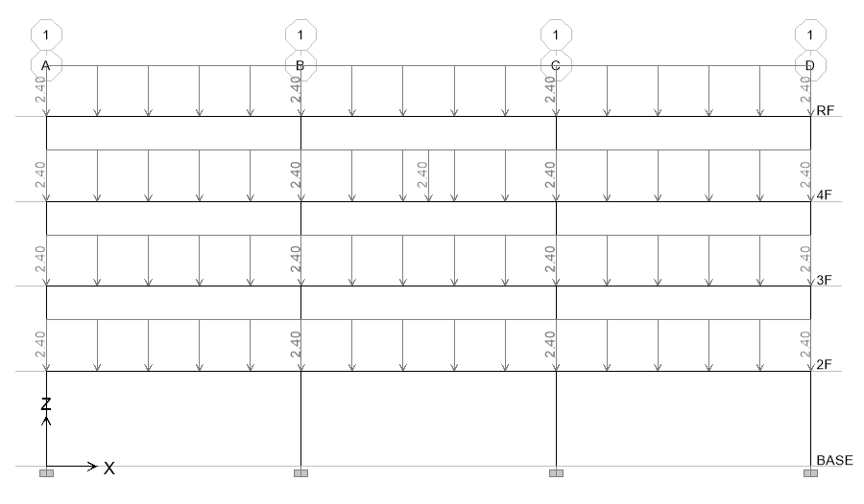
11 Models
Notes:
LowSeismic4Floor12M 0

Slide 26
Evaluation
$$\frac{Seismic Load}{Gravity Load}=Small \& Long Span$$
$$\frac{Seismic Load}{Gravity Load}=Large \& Short Span$$
Notes:
大部分是直通筋，不太準

Slide 27
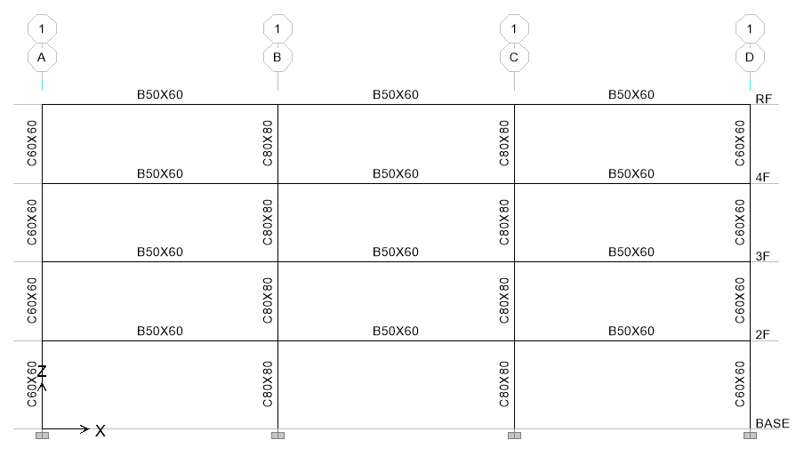
Evaluation
3
47.9s
12 支梁
4
3.9min
5
23.1min
6
2.0hr

Slide 28
台北住宅案
100.1%
OVERALL RESULT
14F B3
101.3%
TOP RESULT
98.5%
BOT RESULT
20m
30m
Notes:
由於很複雜，先記得最終的結果
400

Slide 29
9F B1
93.4%
OVERALL RESULT
92.3%
TOP RESULT
153m
77m
94.7%
BOT RESULT
高雄物流中心
Notes:
3500

Slide 30
Cost Analysis
Reduced Percentage
Material Reduced Cost
$$Δ=−\frac{60kg}{m^{2}}∗2\%∗\frac{\$28}{kg}=−\$33.6/m^{2}$$
Girder Used
Material Cost

Slide 31
Cost Analysis
Increase
Construction Cost
Reduced
Material Cost
$$Δ=\frac{\$100}{t}∗\frac{0.15t}{m^{2}}−\frac{60kg}{m^{2}}∗2\%∗\frac{\$28}{kg}=−\$18.6/m^{2}$$
$$Δ=\frac{\$200}{t}∗\frac{0.15t}{m^{2}}−\frac{60kg}{m^{2}}∗2\%∗\frac{\$28}{kg}=−\$3.6/m^{2}$$
Increase Wage

Slide 32
Cost Analysis
$$Δ=−\frac{60kg}{m^{2}}∗2\%∗\frac{\$28}{kg}=−\$33.6/m^{2}$$
$$Δ=\frac{\$100}{t}∗\frac{0.15t}{m^{2}}−\frac{60kg}{m^{2}}∗2\%∗\frac{\$28}{kg}=−\$18.6/m^{2}$$
$$Δ=\frac{\$200}{t}∗\frac{0.15t}{m^{2}}−\frac{60kg}{m^{2}}∗2\%∗\frac{\$28}{kg}=−\$3.6/m^{2}$$
$$Δ=\frac{\$200}{t}∗\frac{0.15t}{m^{2}}−\frac{60kg}{m^{2}}∗5\%∗\frac{\$28}{kg}=−\$54/m^{2}$$

Slide 33
Outline
Part 2
Part 4
Shear Reinforcement
Nonlinear Verification
Part 1
Part 3
Flexural Reinforcement
Condition

Slide 34
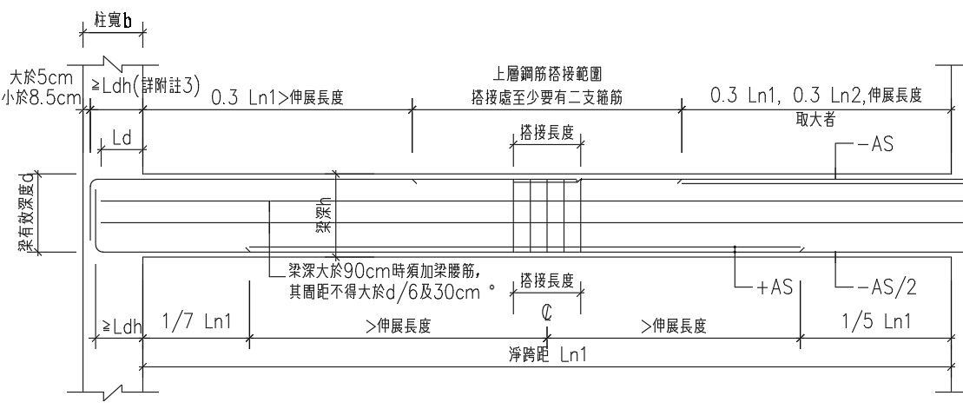
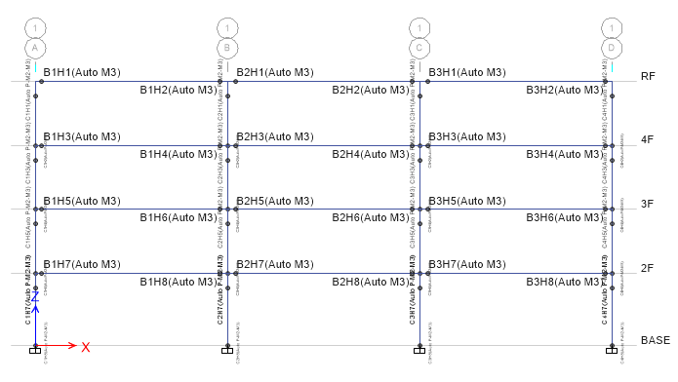
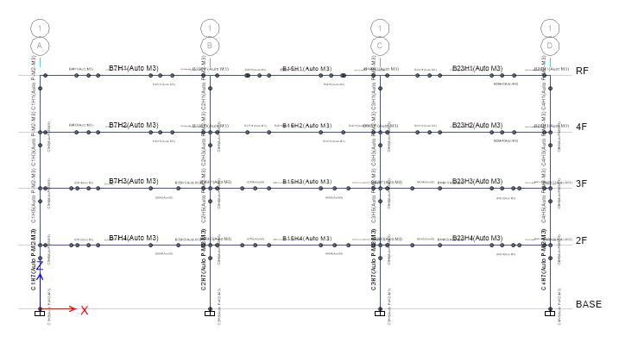
Consider Ld

Slide 35
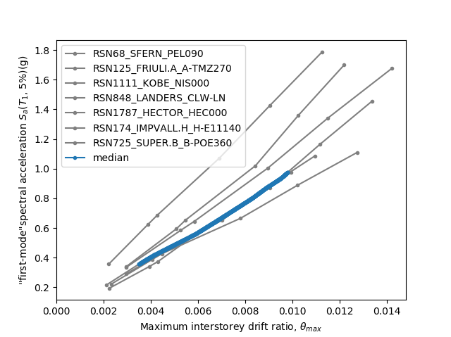
Hinges Only On Ends

Slide 36
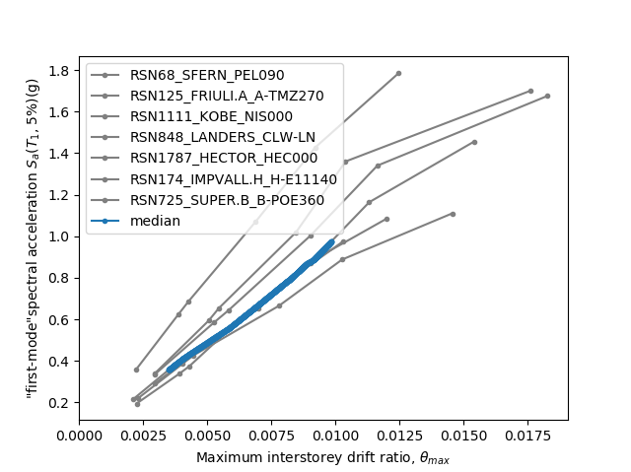
Multiple Hinges

Slide 37
Hinges Only On Ends
Multiple Hinges
0.014
0.017

Slide 38
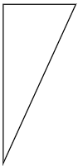
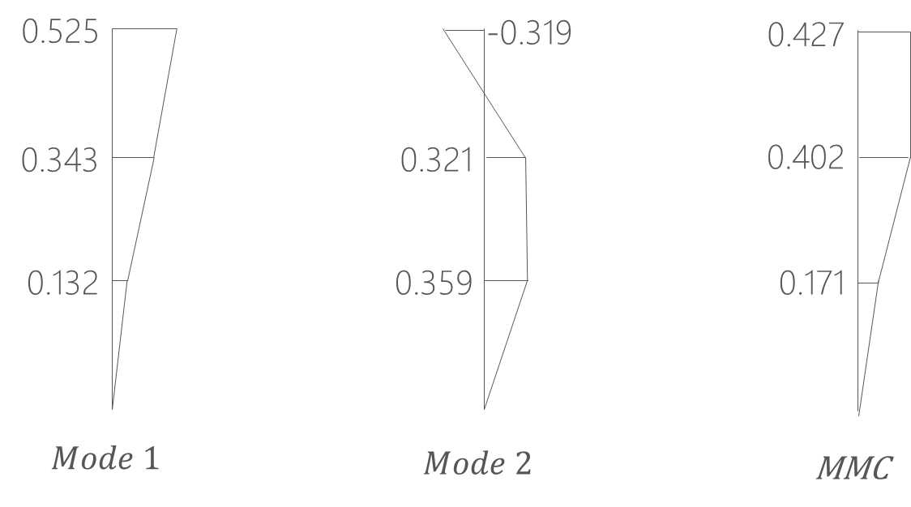
Pushover Load Pattern
Inverted Triangle
Multi-Modes Combination
Modal Pushover Analysis
SRSS
Notes:
定義非線性驗證的邊界

Slide 39
Inverted Triangle

Slide 40
Multi-Modes Combination

Slide 41
Modal Pushover Analysis

Slide 42
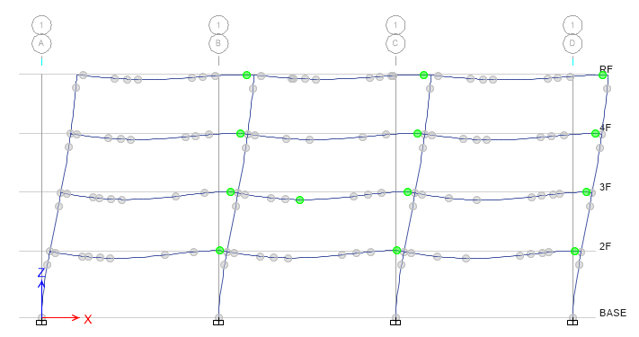
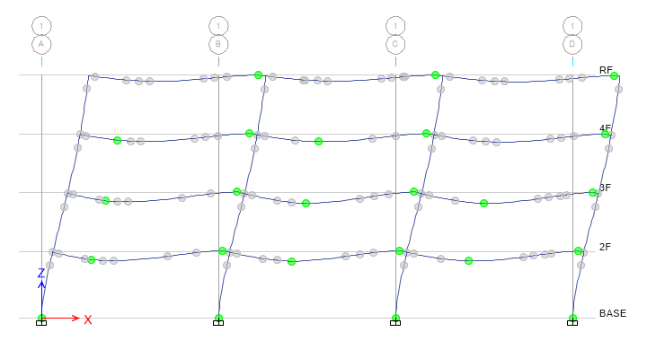
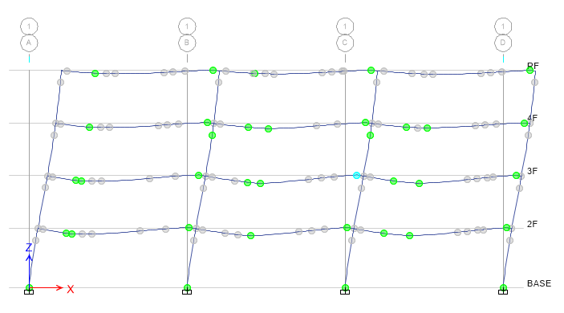
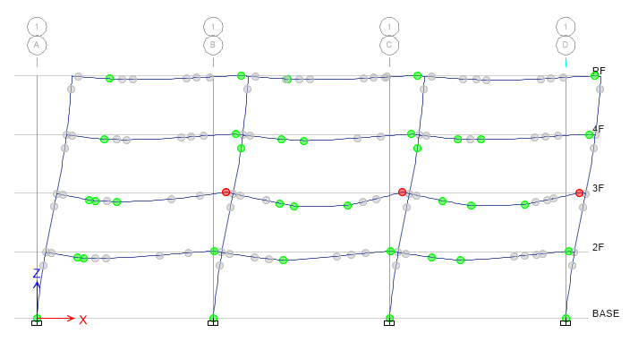
Step 3
Step 5
Step 7
Step 8

Slide 43
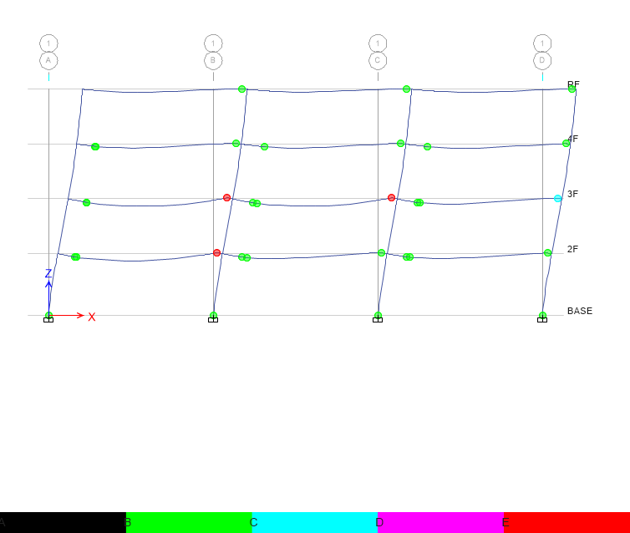
Hinge
Third Hinge
+

Slide 44


Hinge
Without Initial Conditions

Slide 45

Time history
Story Drift
Scaled to DBE, MCE
DBE < 1.5%
MCE < 2%

Slide 46
Scaled

Slide 47


DBE
MCE

Slide 48


Multiple Hinges

Slide 49


Incremental Dynamic Analysis
Single Static Analysis
➔
Incremental SPO
Single Time History Analysis
➔
Incremental One

Slide 50

Non-Linear SPO
Elastic
➔
Match
Non-Negative
➔
Equal Displacement
Negative
➔
Softening

Slide 51


Limit-State
4% FEMA273
2.5% SEAOC2000

Slide 52







